Slide 1







2026-2027 CTSO Annual Submission Walkthrough

Slide 2

Annual Chapter Submission Location
CTE Data Portal
azed.gov → ADEConnect → Applications → CTE Data Portal → CTSO
Chapter Annual Submission (Formally 7a) Deadline
Fall: December 1, 2026
Spring: March 1, 2027

Slide 3
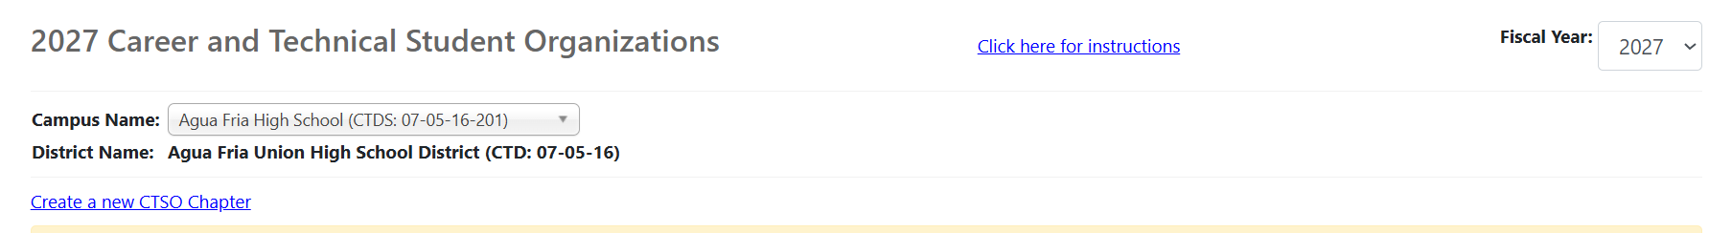
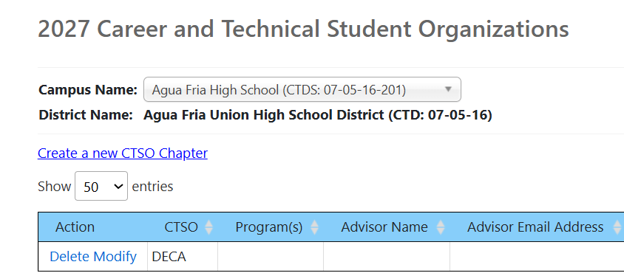
Once in the Data Portal…
Starting a New Submission
On the main CTSO page, use the button that says “Start a New CTSO Chapter”. This allows you to start a new submission.
Editing a Submission that was Saved as a Draft
On the main CTSO page, use the
“Modify” button to edit the draft.
How do you Check Submission Status?
On the submission table, there is a box for the submission that will say “Draft”, “Submitted to ADE”, “Accepted”, or “Returned for Edits”

Slide 4
Frequently Asked Questions
What is this form?
This form serves as a central submission place for all chapter documents. This is an annual submission, not just when your CTE program is being monitored.
Why do we have to submit every year?
One requirement of membership for each CTSO is to have each of these documents on file with ADE each year. Additionally, if the chapter or district misplaces their files, we have recent uploads for each of the compliance documents, ultimately helping YOU as an advisor.
Who has to submit to this form?
CTSO advisors have to submit this form for each CTSO they advise or serve as a co-advisor. For example, if you are the DECA and HOSA advisor, you will need to submit this form for both your DECA chapter and HOSA chapter. If the FCCLA chapter has both Culinary and Early Childhood Education, the form only has to be submitted once

Slide 5
Data Portal Frequently Asked Questions
What is the Data Portal?
The Data Portal is a live ADE Hub that is housed within the Arizona Department of Education ADEConnect application. This portal is not linked to a 3rd party (ex. Jotform) which makes the data more secure. You can only access the Data Portal through ADEConnect.
What do I do if I don’t have access to the Data Portal?
We have created advisor access for CTSO submissions; however, please work with your school admin for a solution that works for your school.
How does it work?
Advisors will submit their annual chapter documentation to be reviewed by the state CTSO team. Once reviewed, the CTE director and advisor will receive a live update on approval or if it needs modification (with notes) and resubmission.

Slide 6
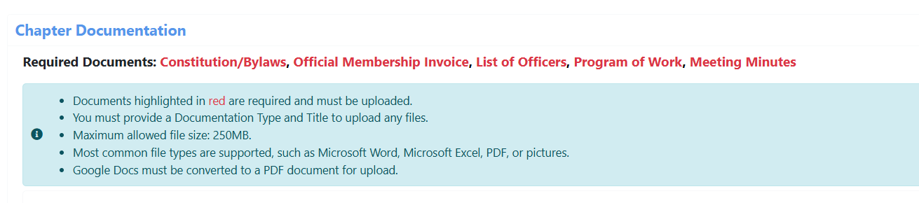
Annual Chapter Submission Form Elements
  Levels of Access
  Chapter Information
  Chapter Constitution and/or Bylaws
  Membership/Officers
  Program of _______
  Meeting Minutes
  Statement of Assurance

Slide 7
Teacher/Advisor Level
District
Level
Data Portal Access
Which access level type is right for your CTSO?
01
Can only access the CTSO portal page
01
Able to access the CTSO page and other CTE pages
02
Able to access and submit for their CTSO only
02
Able to access and submit for an entire district
03
Submission Status View
03
Ability to pull reports regarding status for all submissions

Slide 8
Chapter Information
To start the form, some basic information needs to be established:
  Your log-in will autofill the school; however, you will need to input the program and the advisor information
    If you need assistance finding your Educator Identification Number (EIN), you can look it up at https://mycert.azed.gov/public
  Please select the CTSO you are submitting for and all programs that are in the chapter. You will also be prompted to enter the CTSO Chapter ID
    Please note, the programs available are only programs your school has been approved and reported students for.
  You will need the school’s Invoicing/Billing Address on this section

Slide 9
Important Notes
Chapters need to have their Chapter ID available.
If you are not sure about what CTSO you are affiliated with, reach out to a campus administrator or district CTE director
For questions about Private/Parochial school CTSO requirements, please reach out to CTELocalPrograms@azed.gov or the State Advisor for the CTSO you are affiliated with

Slide 10
Constitution/Bylaws
  The uploaded document(s) must be your chapter’s constitution/bylaws
    Uploads of incomplete documents, the organization’s constitution/bylaws, or constitution/bylaws for another chapter will not be accepted
  Constitution/bylaws must be reviewed and approved yearly by the advisor and the chapter officer team and the date needs to be on the document.
    Documents without a review date in the current year will be rejected
Bylaws will be uploaded and can be found here!

Slide 11
Frequently Asked Questions
Do I use the Sample Constitution/Bylaws?
The Sample Constitution and/or Bylaws should only be used for new chapters. new advisors should contact their state advisor for the previous year’s documents.
How often do I have to review my Constitution/Bylaw?
Every year! The Constitution/Bylaws have to be reviewed or revised with your chapter every year. The revision/review date should be on the bottom of the Constitution/Bylaws and submissions will not be accepted without it.

Slide 12
Membership
Membership refers to affiliated members. In order for students to compete and be an official member of each respective CTSO, they must be affiliated and each chapter to hold no outstanding balance.
  Official invoices are required for each CTSO. FFA’s Membership Contract is accepted
  A typed/written list of members is not an approved upload
  Districts that register all chapters at once may submit a combined invoice.
The Official Membership Invoice will be uploaded and can be found here!

Slide 13
Membership
NEW THIS YEAR:
Prior to March 1 -
An invoice of members will be entered for the Annual Chapter Submission
After March 1 -
You will need to provide a numerical count of non-secondary student members in addition to adding the student roster into the form. Students will be searchable by Student ID number or First/Last Name.
All chapter submissions will be sent back to the advisor’s portal for membership data entry after March 1

Slide 14
Members and Chapter Officers
Chapter Officers
    These students should be active, affiliated members of your chapter
  Members and chapter officers can be added one of two ways:
    Dropdown list selection
      Only available if the school has already submitted enrollment for the school year
      Students enrolled will be included in a dropdown list and can be selected. SUID will auto populate
    SUID
      Must be used if enrollment has not been submitted or if student is not currently enrolled in the program for the fiscal year but still in the CTSO (ex Program Completer)
      SUID will be typed in, and student name will auto populate

Slide 15
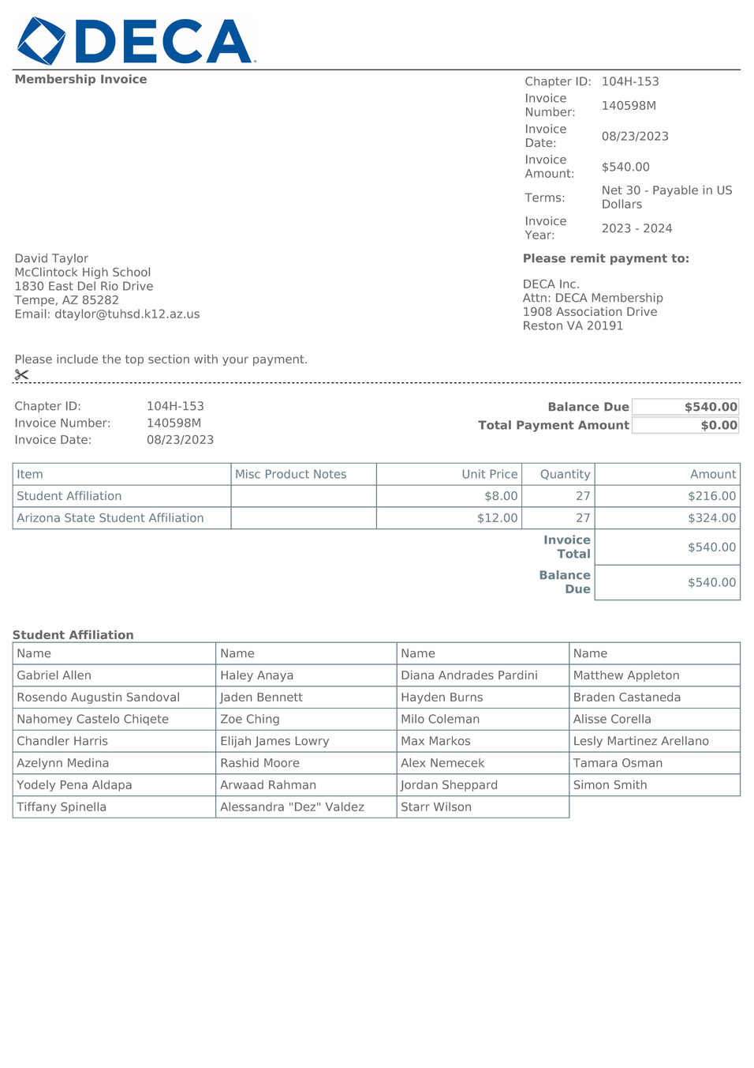
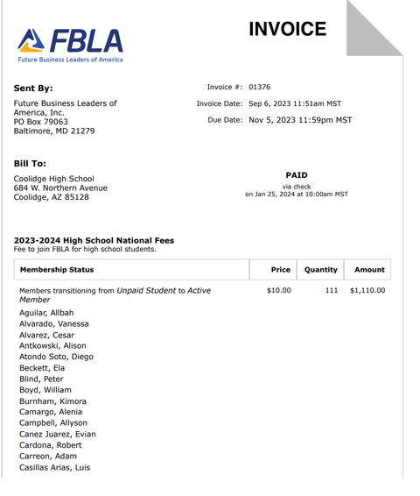
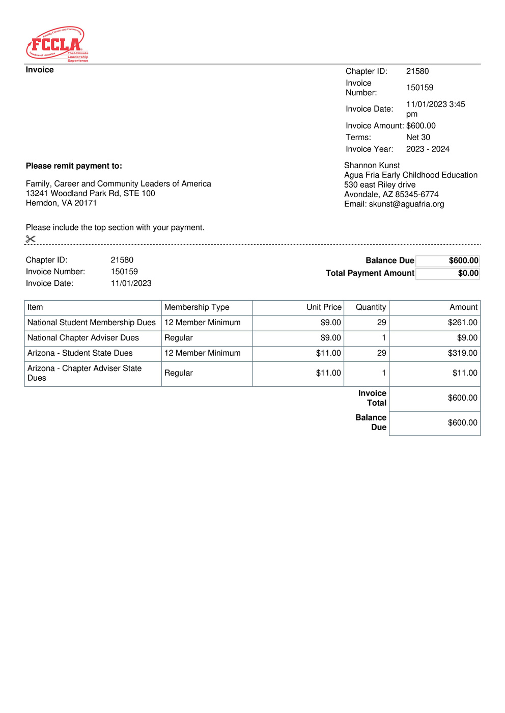
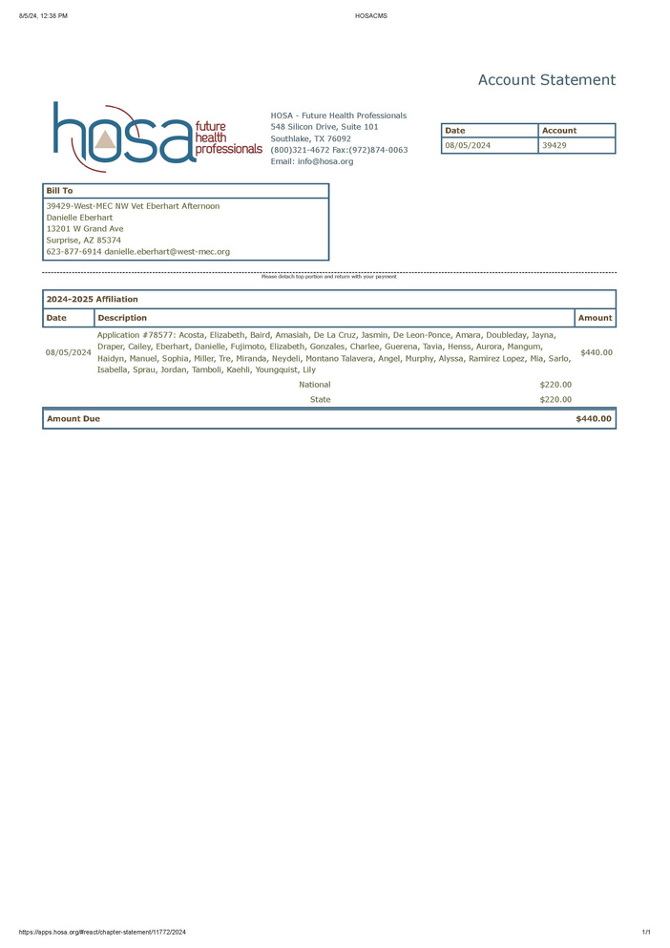
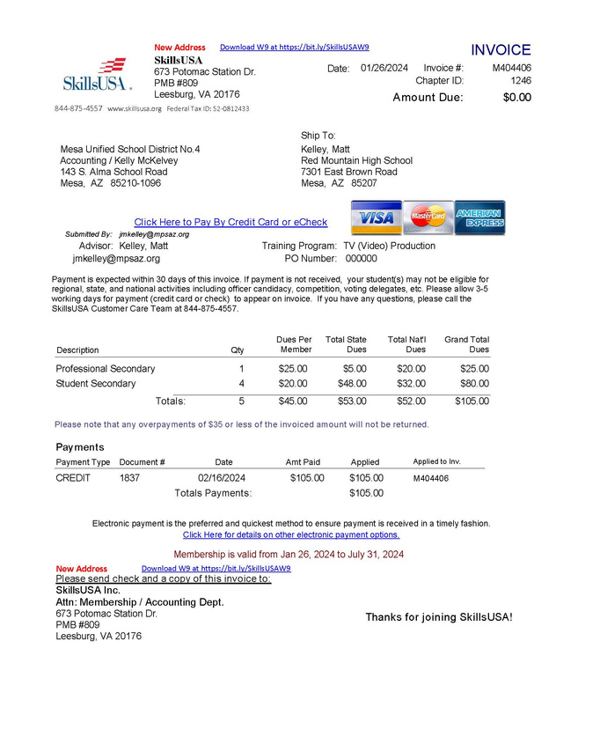
Example of Membership Uploads
& FFA’s Membership Contract

Slide 16
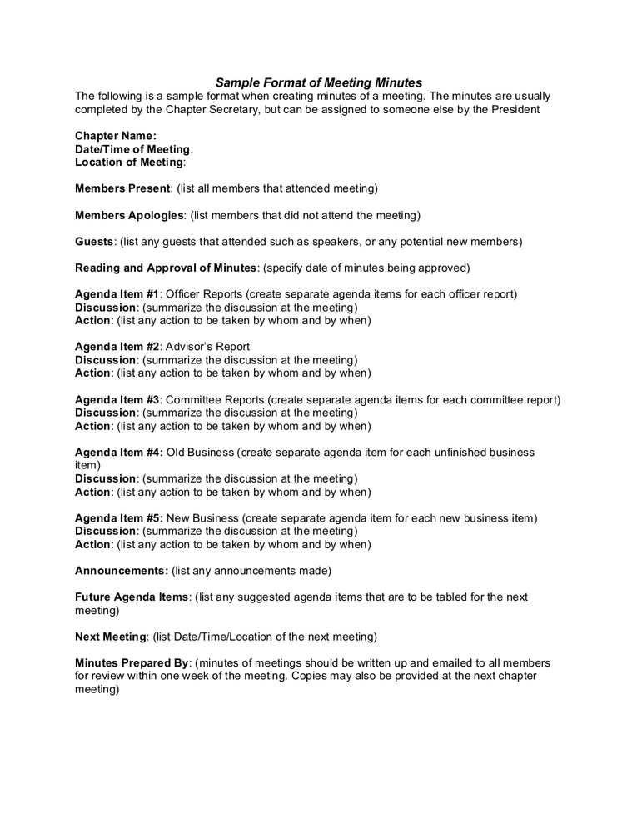

Meeting Minutes
Two Meeting Minutes are required. They must be from different meetings in the current school year
Meeting minutes should include
  Which students were in attendance
  The date of the meeting
  A written summary and any action items
Meeting Minutes will be uploaded here

Slide 17
Program of Work or Leadership
.
  The Program of Work template for FBLA, FCCLA, HOSA, and SkillsUSA is the only PoW format that will be accepted.
    If you do not have the template, it is linked to the blue “Program of Work” text and can be found on the ADE Website
    Your Program of Work should be a tool for you and your chapter!
  DECA must submit the Program of Leadership
  FFA must submit the Program of Activities
Program of Work/Leadership/Activities will be uploaded and can be found here!

Slide 18

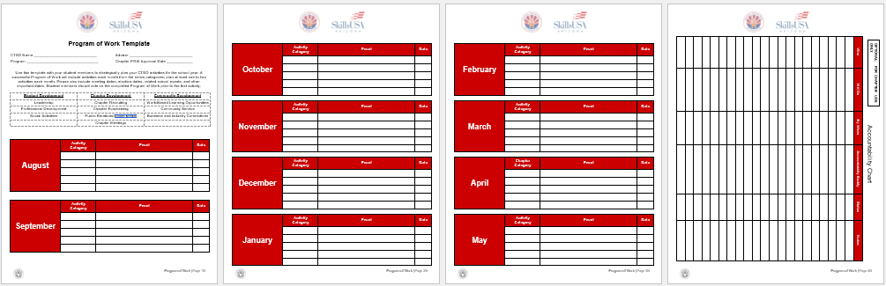
Program of Work/ Leadership/Activities
Instead of the Program of Work, DECA requires a Program of Leadership and FFA requires a Program of Activities

Slide 19
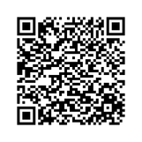
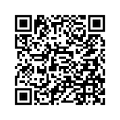
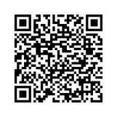
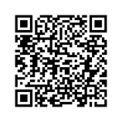
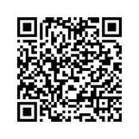
Statement of Assurance
The statement of assurance for each CTSO provides a clear understanding of the expectations for Conference Liability & Release Form
  The CTSO that was indicated in step one will determine which upload will be visible to you
  The Conference Liability & Release Form can be accessed on each of the respective CTSO’s websites or via the blue link in the statement of assurance
This will be on the form as a signature field.
DECA
FBLA
FCCLA
HOSA
SkillsUSA

Slide 20
CTE Program Monitoring 7b
7b Submissions evaluate the quality of activities a chapter participates in.
  Chapter Awards is the only available pathway to 7b Quality Points
  Programs being monitored in the 2026–2027 school year that wish to receive quality points must have submitted documentation for their respective chapter award
  in the prior school year. For example, a monitored school in
  2028–2029 must have received the chapter award in 2027–2028

Slide 21
For any questions:
Julie Ellis
julie.ellis@azed.gov
Megan Victory
megan.victory@azed.gov

