Slide 1
FLC Step-by-Step Registration Guide

Slide 2
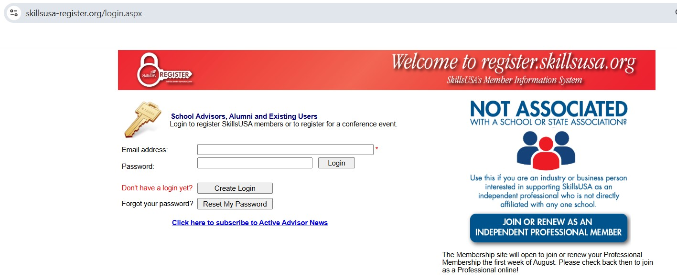
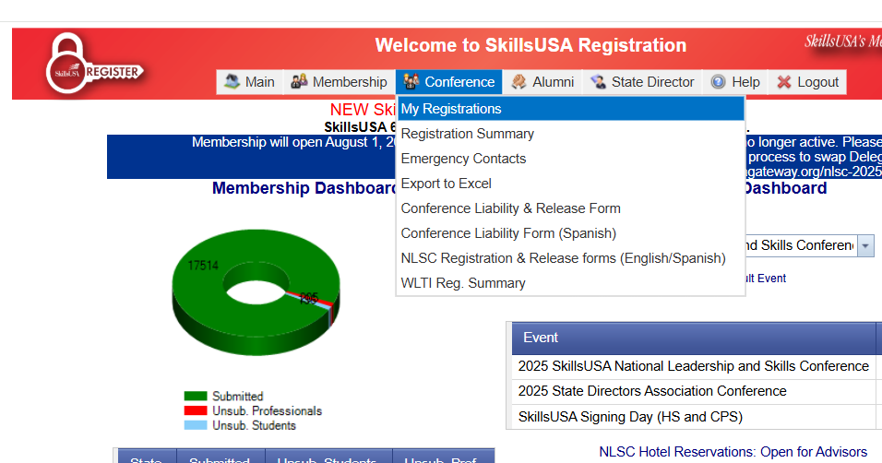
1. Login at: https://www.skillsusa-register.org/login.aspx
2. Click on Conference and then My Registrations.

Slide 3
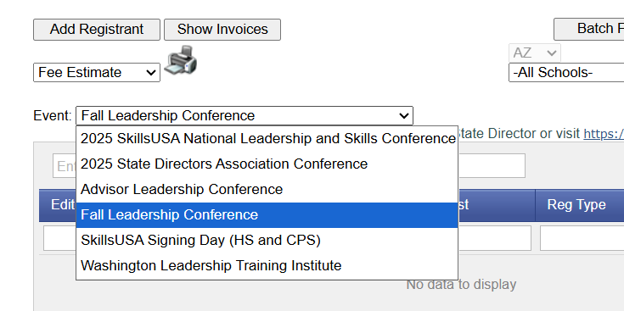
3. Use the drop down box to select Fall Leadership Conference.
4. Then click on Add Registrant.

Slide 4
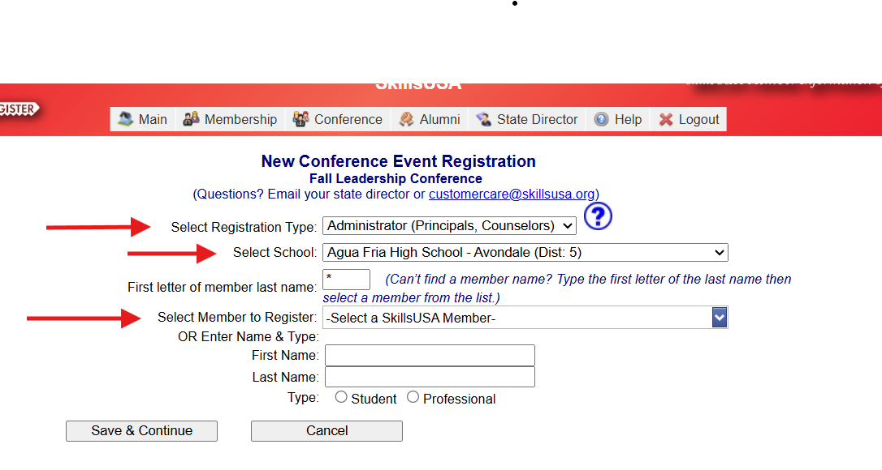
5. Use the drop downs to select Registration Type, School, and Member to Register.
6. Click Save & Continue

Slide 5
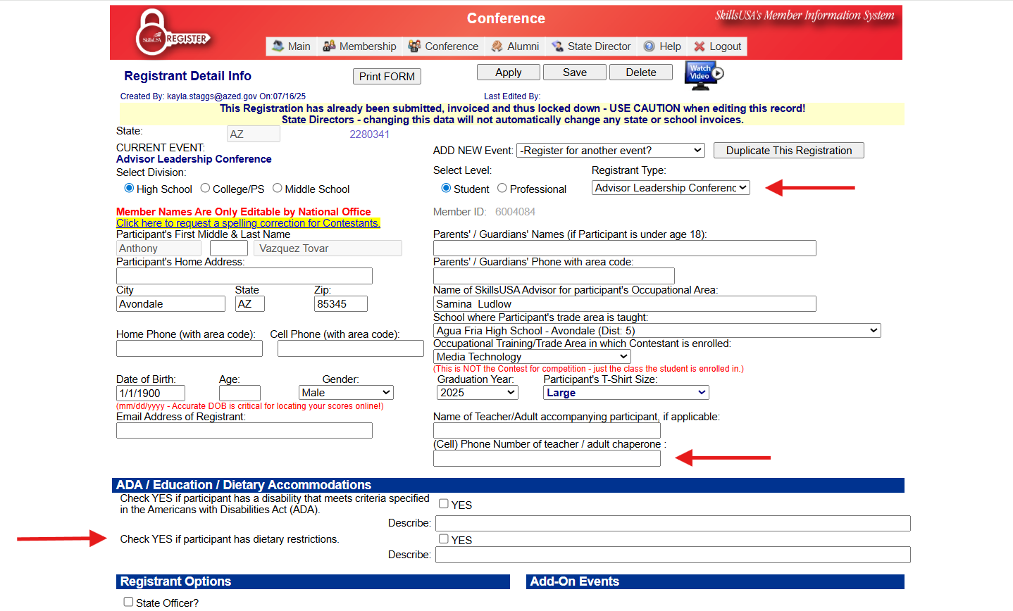
7. Complete the registration form and be sure to:
- Confirm your Registration Type is correct.
- Enter a cell phone number.
- Please describe any dietary restrictions or needs.

Slide 6
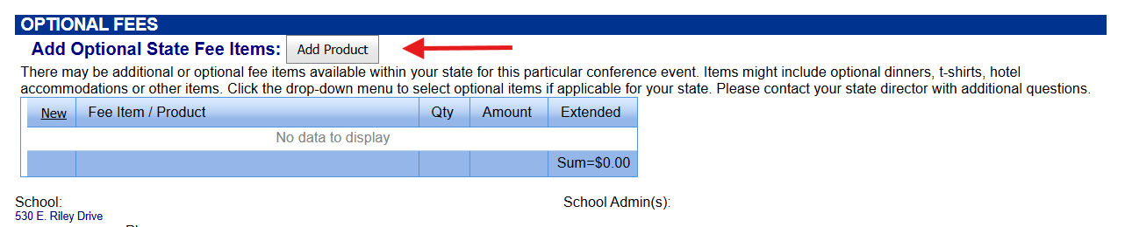
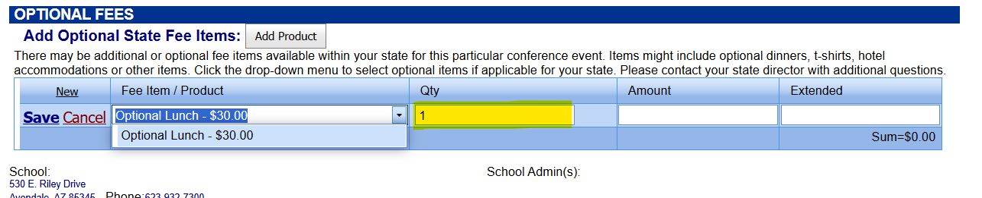
8. If you wish to purchase lunch, you can add-on this fee under Optional Fees.
Click Add Product.
9. Then use the drop down arrow to select Optional Lunch - $30.00 and enter the quantity, or number of lunches you wish to purchase, under Qty.

Slide 7
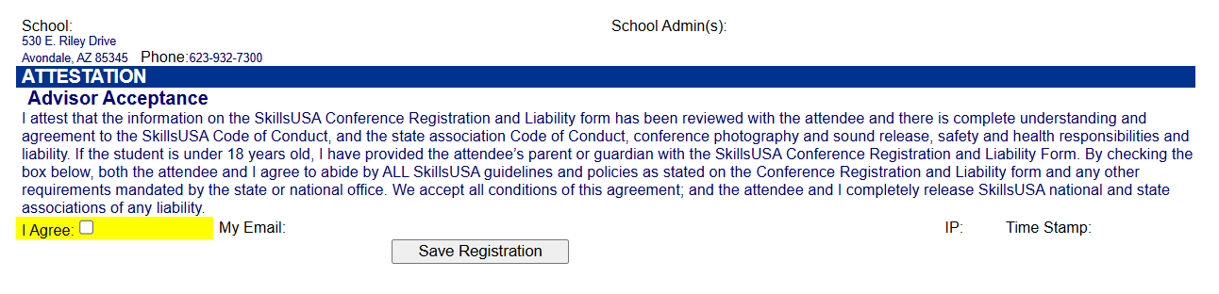
10. Once complete, don’t forget to Save Registration.

