Slide 1







2025-2026 CTSO Annual Submission Walkthrough

Slide 2

Frequently Asked Questions
What is this form?
This form serves as a central submission place for all chapter documents. This is an annual submission, not just when your CTE program is being monitored.
Why do we have to submit every year?
One requirement of membership for each CTSO is to have each of these documents on file with ADE each year. Additionally, if the chapter or district misplaces their files, we have recent uploads for each of the compliance documents, ultimately helping YOU as an advisor.
Who has to submit to this form?
CTSO advisors have to submit this form for each CTSO they advise or serve as a co-advisor. For example, if you are the DECA and HOSA advisor, you will need to submit this form for both your DECA chapter and HOSA chapter.

Slide 3
What is the Data Portal?
What is the Data Portal?
The Data Portal is a live ADE Hub that is housed within the Arizona Department of Education. This portal is not linked to a 3rd party (ex. Jotform) which makes the data more secure.
What do I do if I don’t have access to the Data Portal?
We have created advisor access for CTSO submissions; however, lease work with your school admin for a solution that works for your school.
How does it work?
Advisors will submit their annual chapter documentation to be reviewed by the state CTSO team. Once reviewed, the CTE director and advisor will receive a live update on approval or if it needs modification (with notes) and resubmission.

Slide 4
Chapter Annual Submission (Formally 7a) Deadline
Fall: December 1, 2025
Spring: March 1, 2026

Slide 5

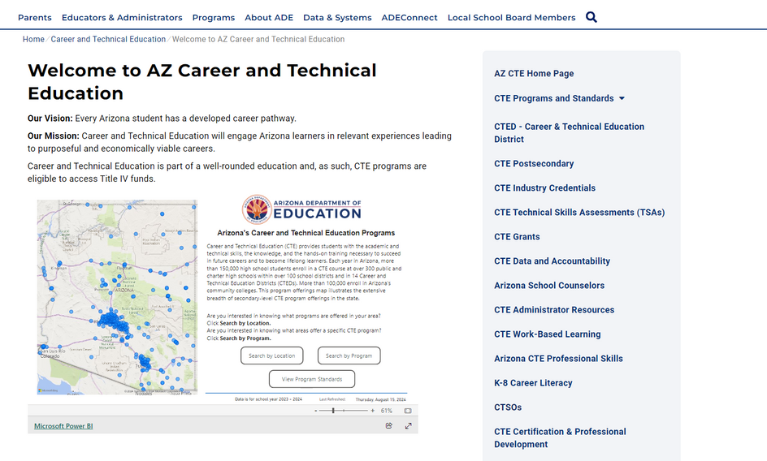
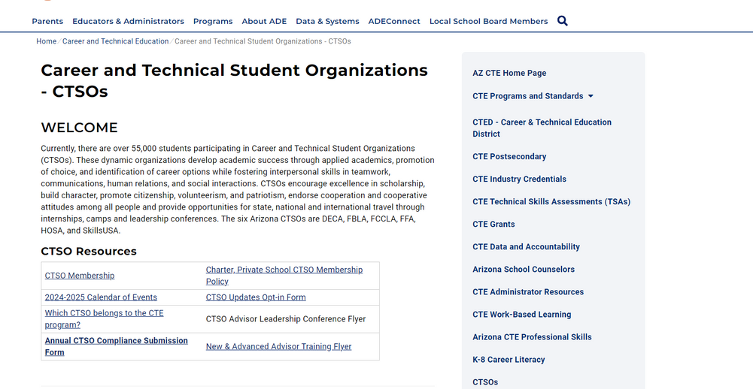
Getting to the Form
From The ADE Website:
  Go to Programs
  Click on Career & Technical Education
  Scroll down and click on CTSOs
  Under CTSO Resources, click on Annual CTSO Compliance Submission Form

Slide 6


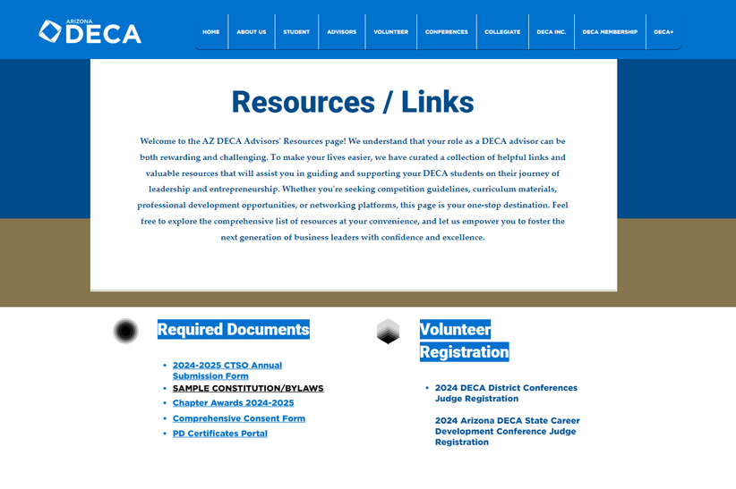
Getting to the Form - DECA
From The DECA Website:
  Start at the the Home Page
  Click on the “Advisors” Tab
  Click “Resources/Links”
  Under Required Documents, click on 2024-2025 CTSO Annual Submission Form

Slide 7
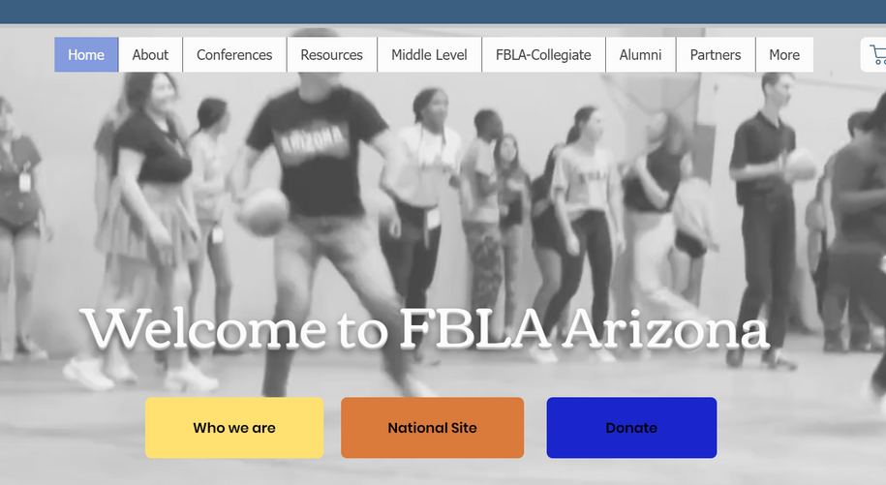
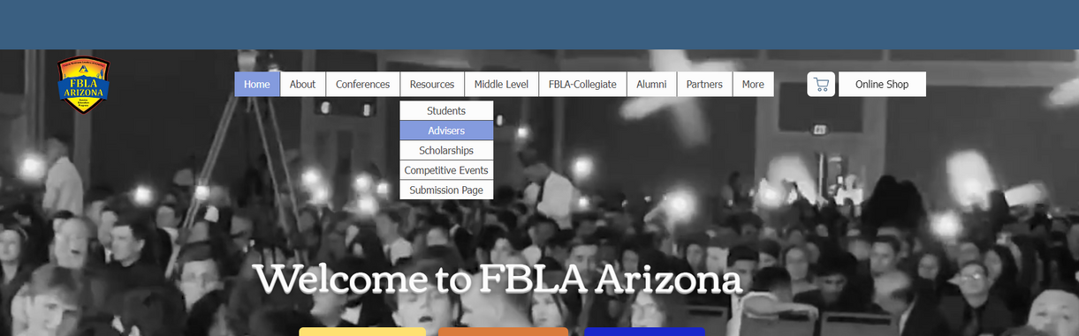
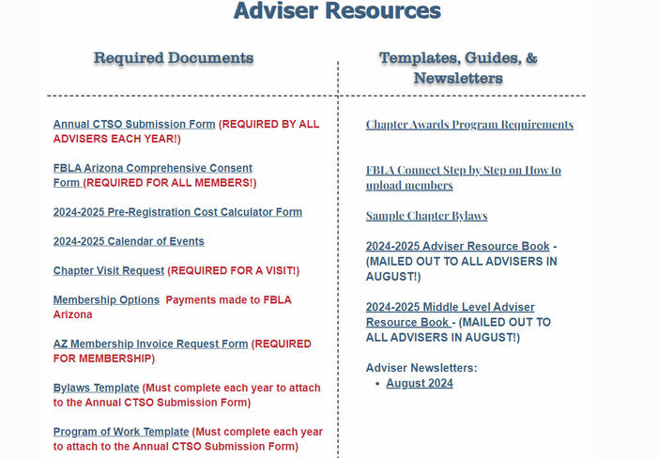
Getting to the Form - FBLA
From The FBLA Website:
  Start on the home page
  Click on “Resources”
  Click on “Advisers”
  Under Required Documents, click on “Annual CTSO Submission Form”

Slide 8

Getting to the Form - FCCLA
From The FCCLA Website:
  Start on the home page, click on the “Annual CTSO Submission Form”

Slide 9
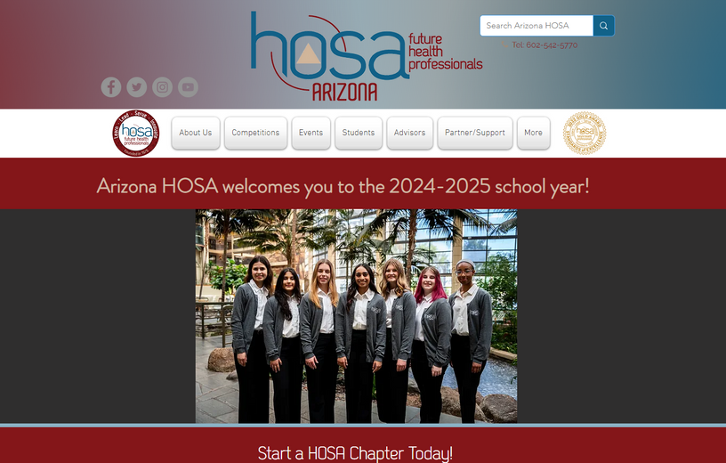

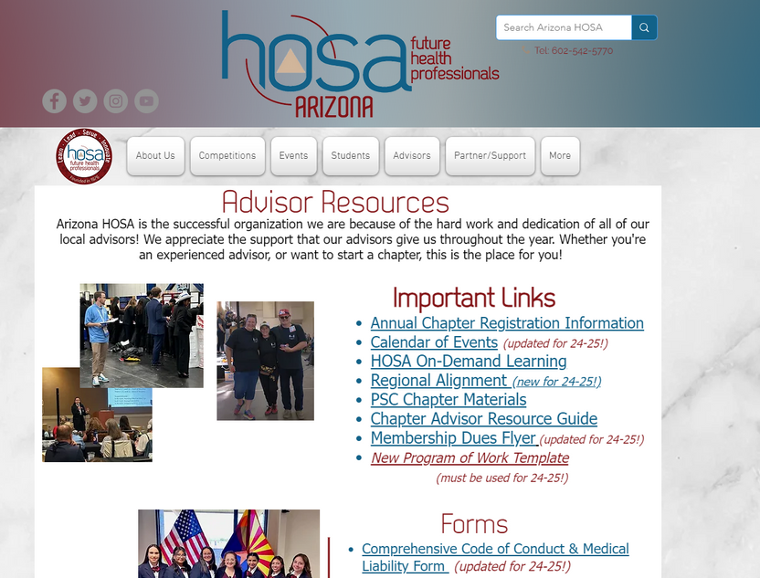
Getting to the Form - HOSA
From The HOSA Website:
  Start on the home page
  Click on “Advisors”
  Click on “Advisor Resources”
  Under “Important Links”, click on “Annual Chapter Registration Information”

Slide 10
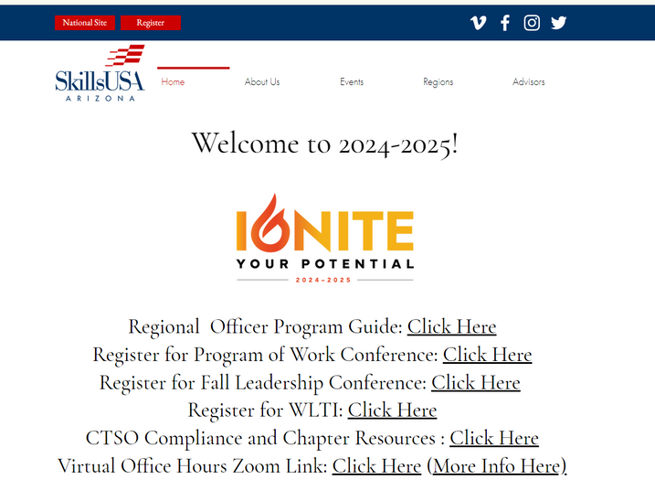
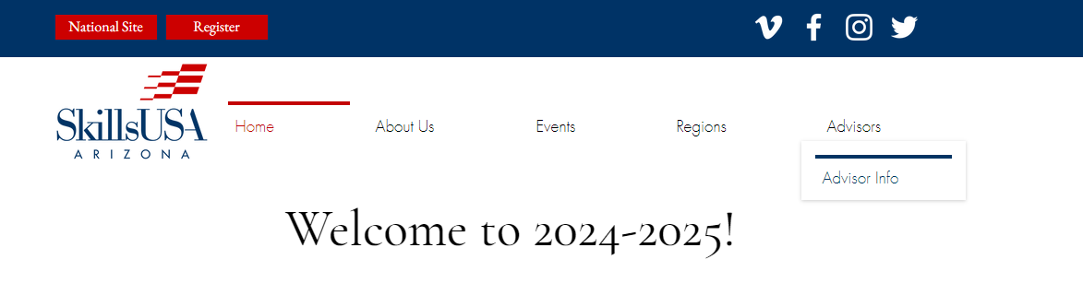
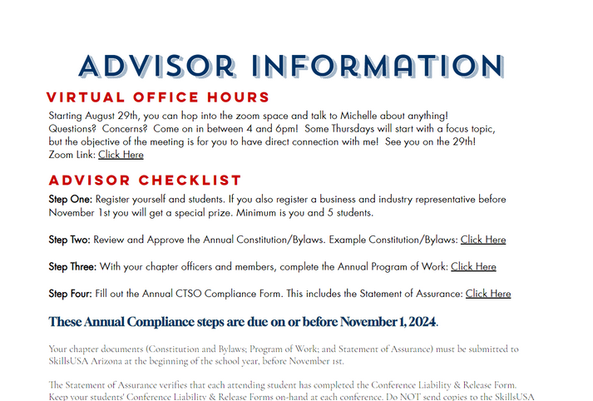
Getting to the Form - SkillsUSA
From The SkillsUSA Website:
  Start on the home page, hover over the “Advisors” tab and click “Advisor Info”
  Scroll down to the “Advisor Checklist”
  Under “Step Four”, click on the “Click Here” link for the Annual CTSO Compliance Form

Slide 11
Annual Chapter Submission Form Elements
  CTSO and Advisor Information
  Membership
  Chapter Constitution and/or Bylaws
  Program of Work, Program of Activities, Program of Leadership
  Meeting Minutes
  Statement of Assurance

Slide 12

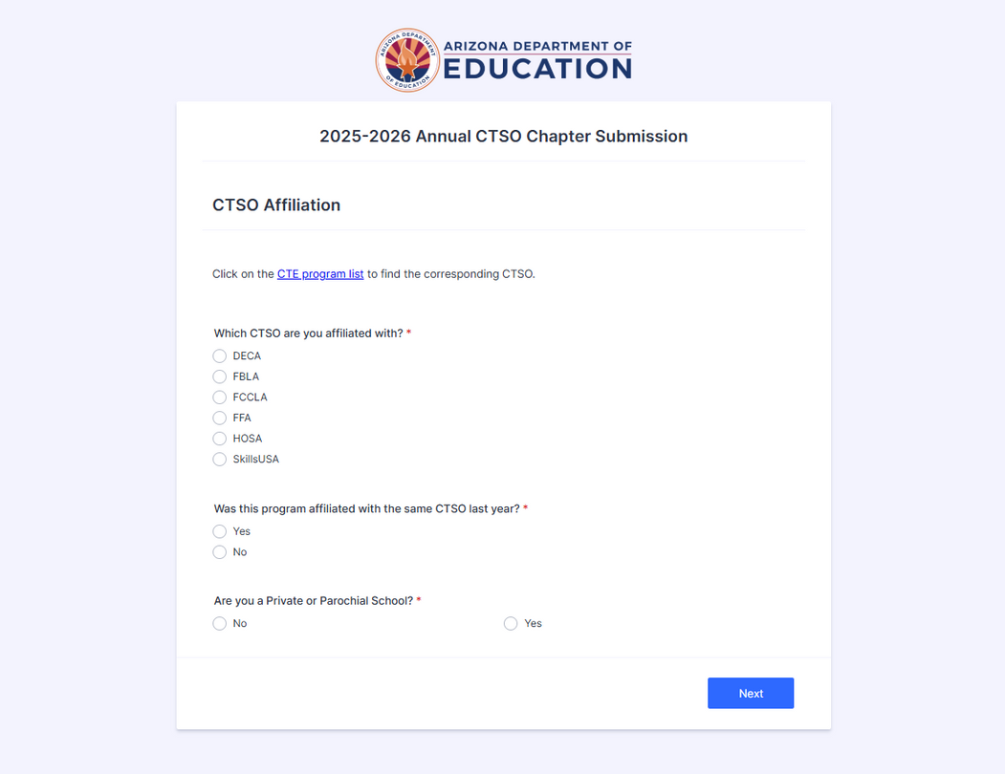
CTSO Affiliation
To start the form, some basic information needs to be established:
  Which CTSO are you affiliated with?
    This question allows the correct person to review your submissions
  Was this program affiliated with the same CTSO last year?
    This allows us to update our records
  Are you a Private or Parochial School?
    These schools have to go through an additional approval process, so this question allows us to follow up if needed

Slide 13



Important Notes
Chapters need to have their Chapter ID available.
If you are not sure about what CTSO you are affiliated with, reach out to a campus administrator or district CTE director
For questions about Private/Parochial school CTSO requirements, please reach out to CTELocalPrograms@azed.gov or the State Advisor for the CTSO you are affiliated with

Slide 14

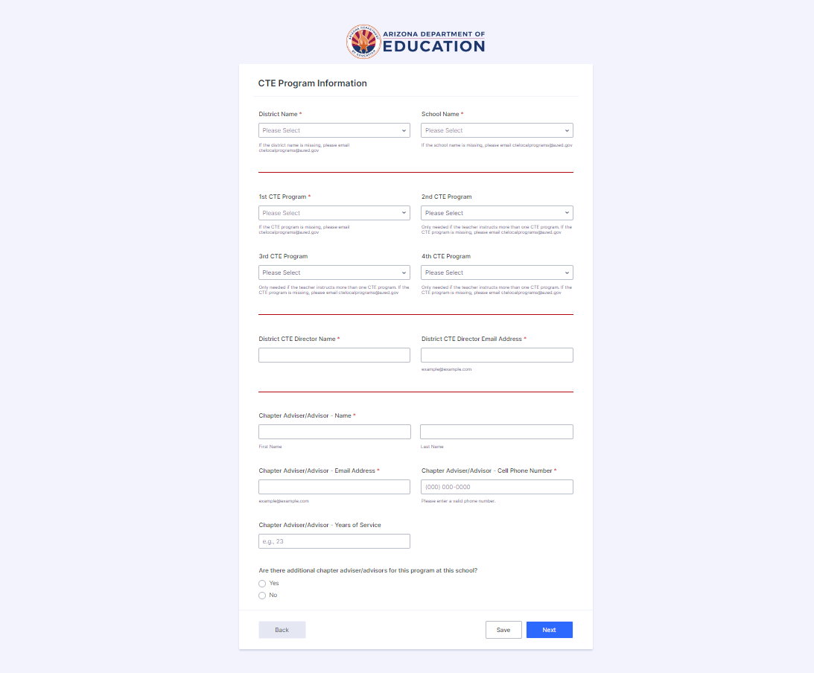
CTE Program Information
  District Name and School Name
    These dropdown selections prevent misspellings and submissions from being filtered out. If your district and/or school name is missing, please do not proceed from this point, and instead email CTELocalPrograms@azed.gov
  1st through 4th CTE Programs
    If you oversee multiple CTE programs within one CTSO, you can input up to four programs in this section and fill this form out once. Only one program is required.

Slide 15
CTE Program Information
  District CTE Director Name and Email Address; Chapter Advisor/Adviser Name, Email, Cell Phone Number, Years of Service
    This information may be used to contact the CTSO Advisor if there are any questions or to connect new advisors to resources. After submitting this form, both contacts will receive copies of the submission with links to PDFs of each upload.
  Are there additional chapter advisors/advisers for this program at this school?
    Up to two additional contacts can be added in this section.

Slide 16

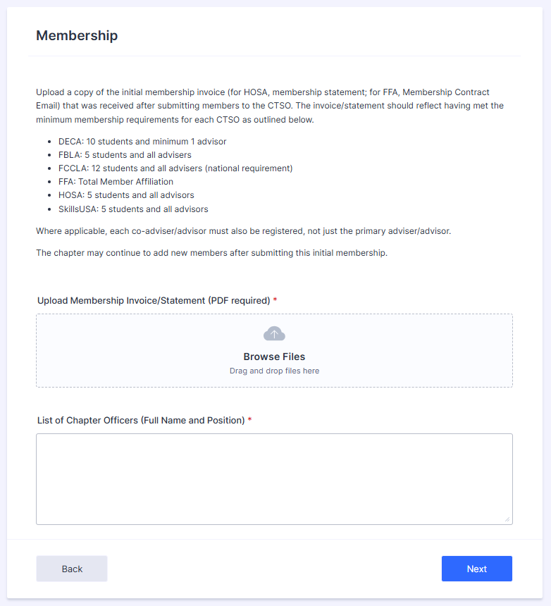
Membership
Membership refers to affiliated members. In order for students to compete and be an official member of each respective CTSO, they must be affiliated and each chapter to hold no outstanding balance.
  Official invoices are required for each CTSO. FFA’s Membership Contract is accepted
  A typed/written list of members is not an approved upload
  Districts that register all chapters at once may submit a combined invoice.

Slide 17
Chapter Officers
List of Chapter Officers
    These students should be active, affiliated members of your chapter
    Please include the full name and position/title of all elected officer positions in the text box provided.

Slide 18
Frequently Asked Questions
Do I use the Sample Constitution/Bylaws?
The Sample Constitution and/or Bylaws should only be used for new chapters. new advisors should contact their state advisor for the previous year’s documents.
How often do I have to review my Constitution/Bylaw?
Every year! The Constitution/Bylaws have to be reviewed or revised with your chapter every year. The revision/review date should be on the bottom of the Constitution/Bylaws (new requirement)

Slide 19

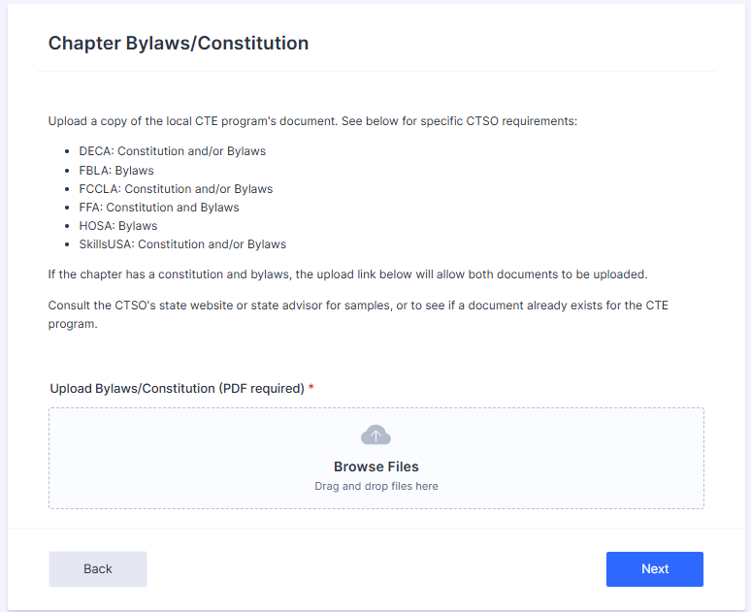
Constitution/Bylaws
  The uploaded document(s) must be your chapter’s constitution/bylaws
    Uploads of incomplete documents, the organization’s constitution/bylaws, or constitution/bylaws for another chapter will not be accepted
  Constitution/bylaws should be reviewed and approved yearly by the advisor and the chapter officer team and the date needs to be on the document.

Slide 20

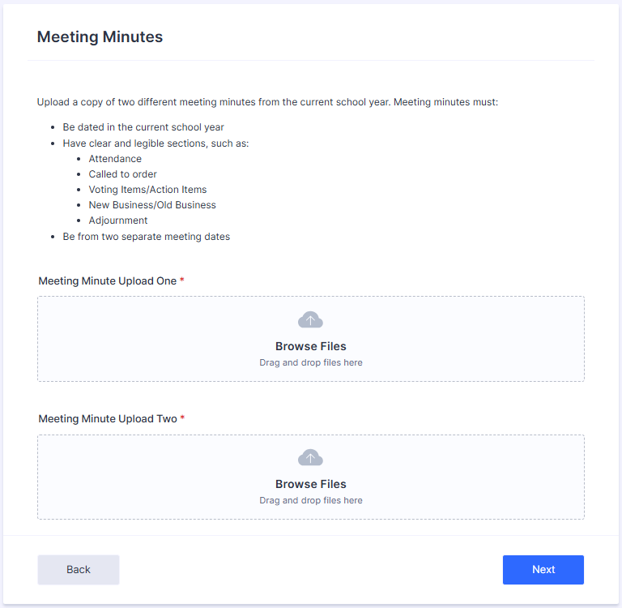
Meeting Minutes
New this year!
Two Meeting Minutes are required. They must be from different meetings in the current school year
Meeting minutes should include
  Which students were in attendance
  The date of the meeting
  A written summary and any action items

Slide 21

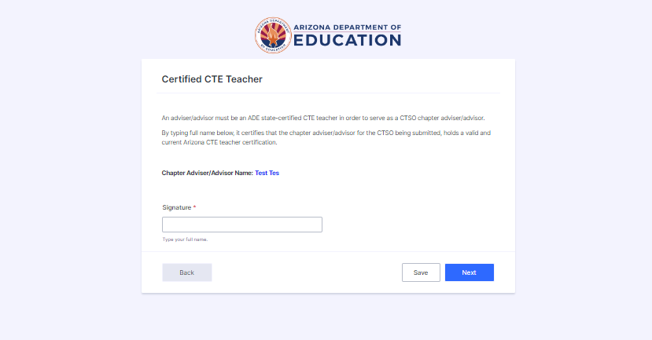
Certified CTE Teacher Affirmation
CTSO Advisors must be ADE-certified teachers. While we do not require an upload of your teacher certification through this form, advisors may be asked to produce a copy of their certification while their program is being monitored.

Slide 22

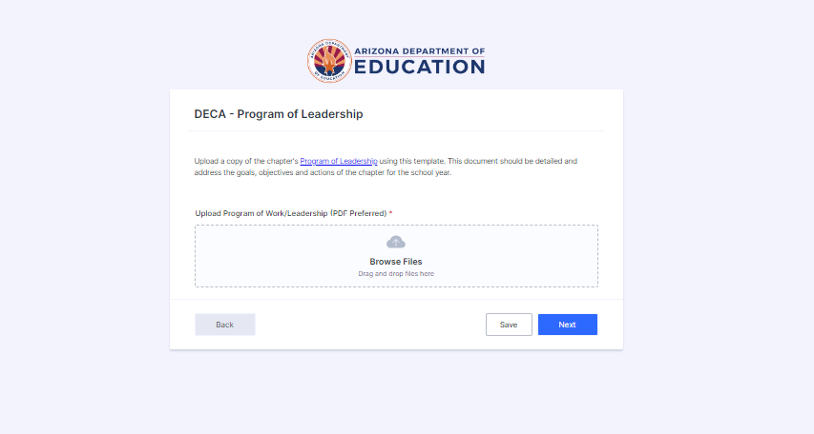
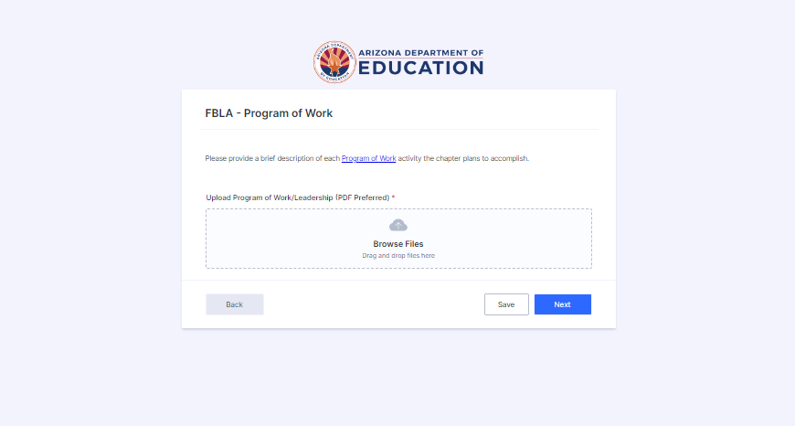
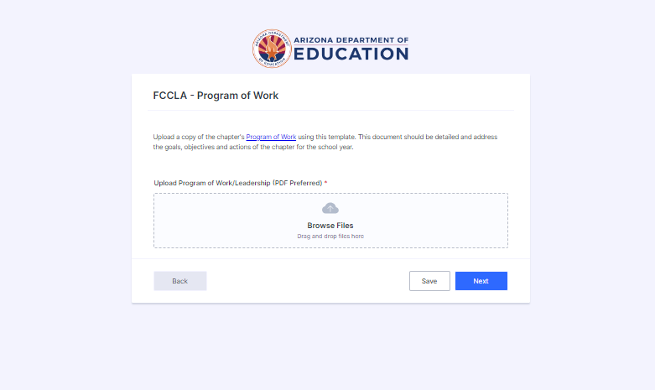
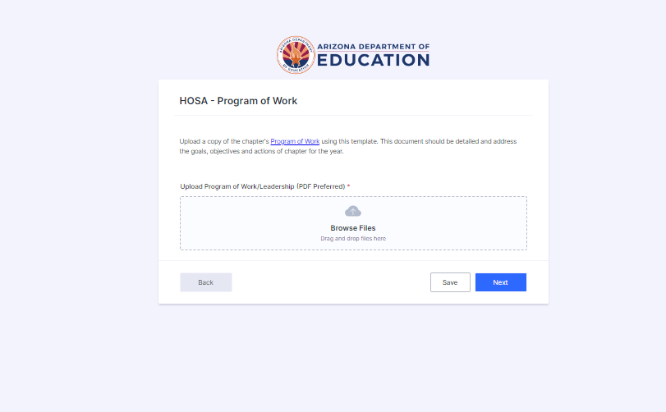
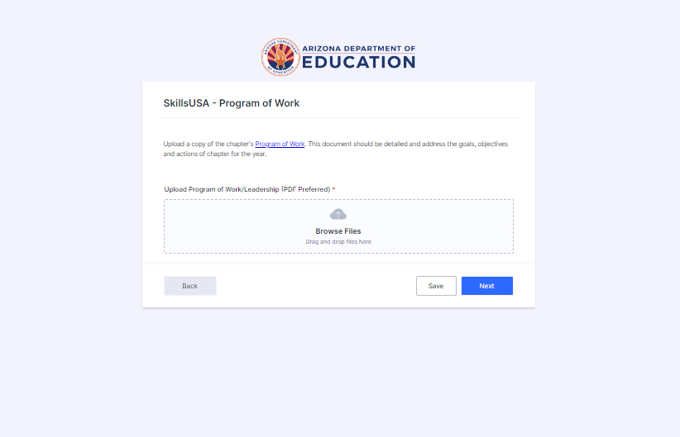
Program of Work or Leadership
.
  The Program of Work template for FBLA, FCCLA, HOSA, and SkillsUSA is the only PoW format that will be accepted.
    If you do not have the template, it is linked to the blue “Program of Work” text and can be found on the ADE Website
    Your Program of Work should be a tool for you and your chapter!
  DECA must submit the Program of Leadership
  FFA must submit the Program of Activities

Slide 23

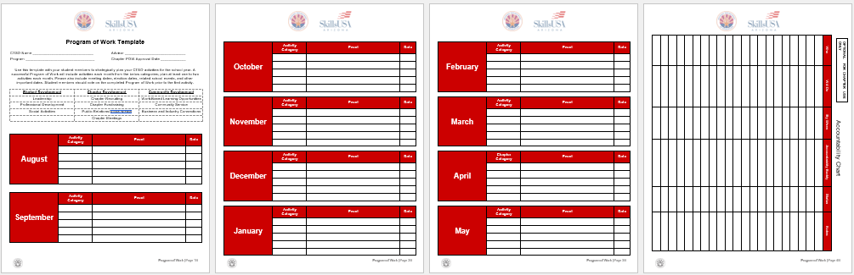
Program of Work/ Leadership/Activities
Instead of the Program of Work, DECA requires a Program of Leadership and FFA requires a Program of Activities

Slide 24

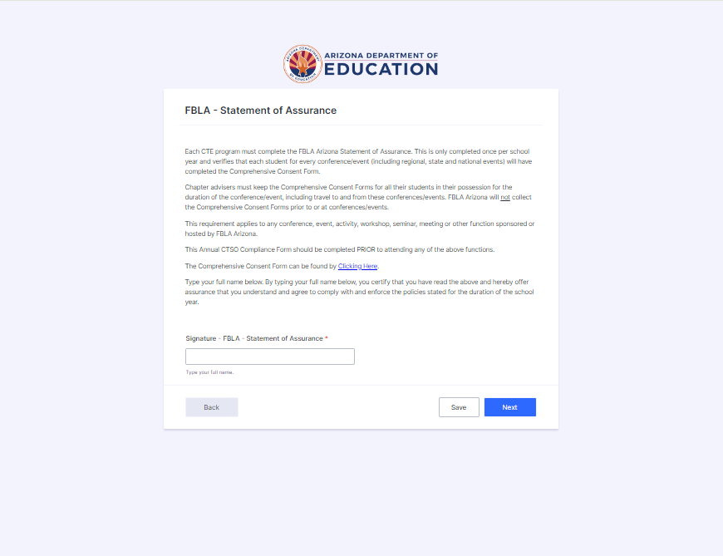
Statement of Assurance
The statement of assurance for each CTSO provides a clear understanding of the expectations for Conference Liability & Release Form
  The CTSO that was indicated in step one will determine which upload will be visible to you
  The Conference Liability & Release Form can be accessed on each of the respective CTSO’s websites or via the blue link in the statement of assurance
This will be on the form as a signature field.

Slide 25
For any questions:
Julie Ellis
julie.ellis@azed.gov
Megan Victory
megan.victory@azed.gov

