Slide 1
ALC Step-by-Step Registration Guide

Slide 2
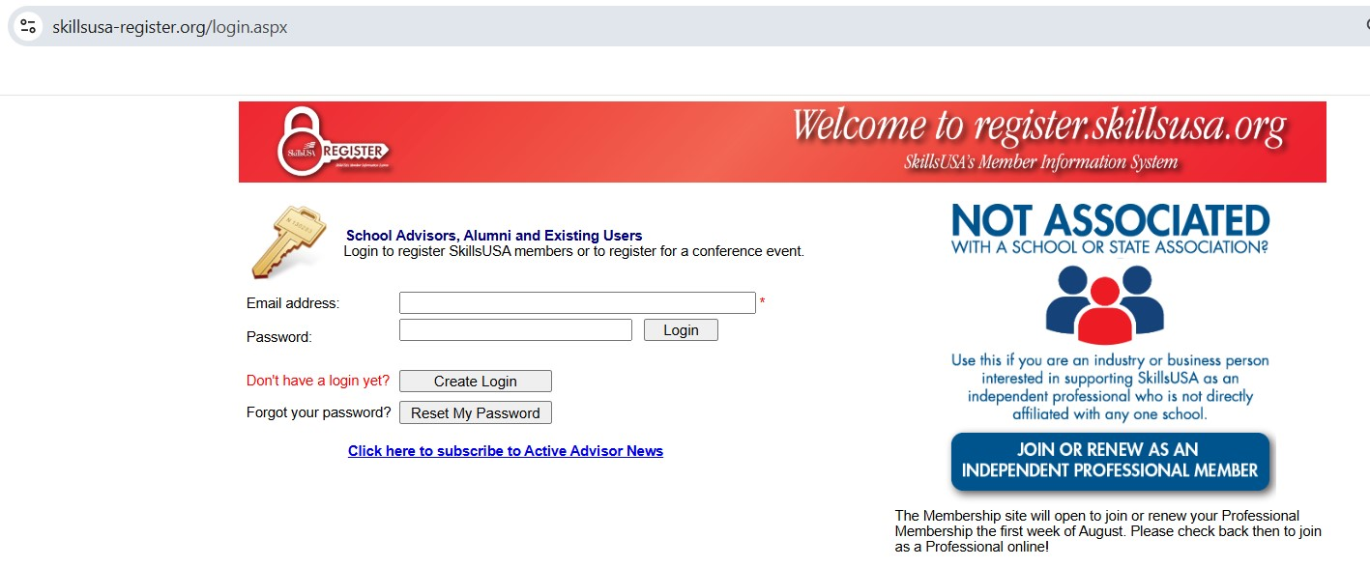
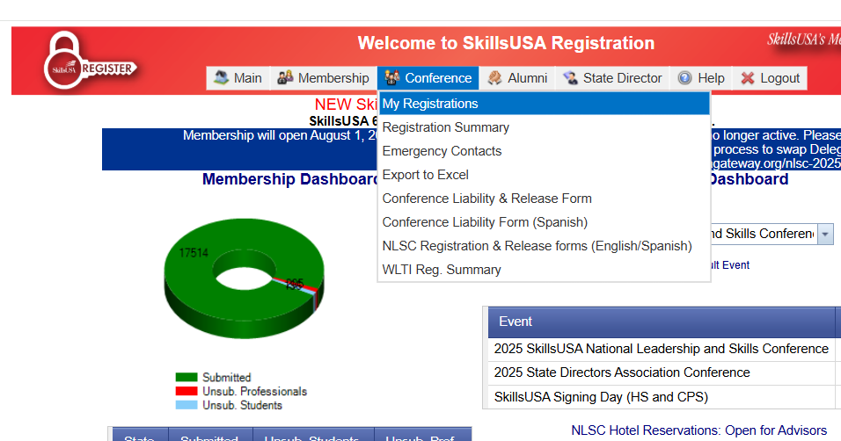
1. Login at: https://www.skillsusa-register.org/login.aspx
2. Click on Conference and then My Registrations.

Slide 3
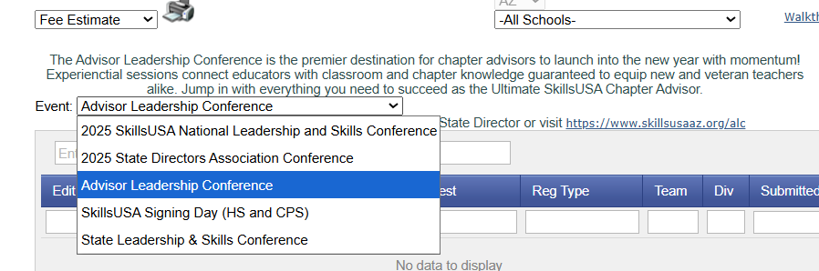
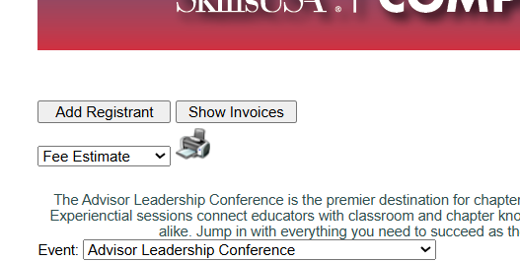
3. Use the drop down box to select Advisor Leadership Conference.
4. Click on Add Registrant.

Slide 4
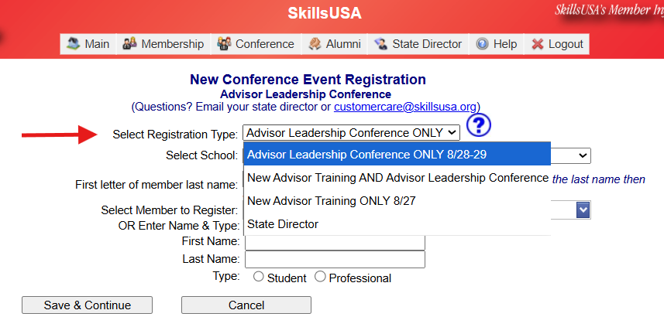
5. Select Registration Type.
Be advised this is different from past years and is based on the days you wish to attend:
- New Advisor Training ONLY 8/27
- New Advisor Training AND Advisor Leadership Conference
- Advisor Leadership Conference ONLY 8/28-29

Slide 5
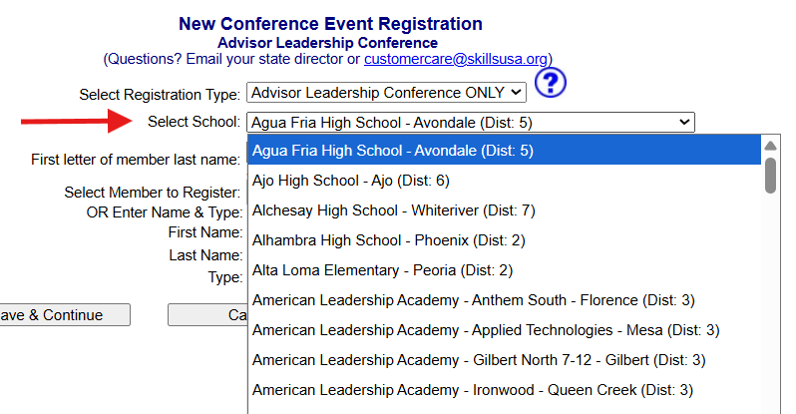
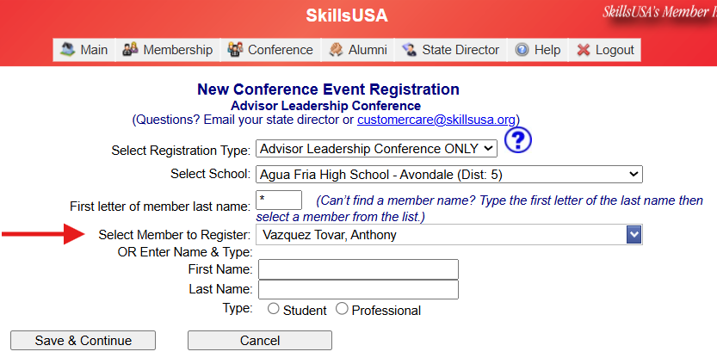
6. Use the drop down to Select School.
7. Use the drop down to Select Member to Register.
8. Click Save and Continue to move to the next screen.

Slide 6
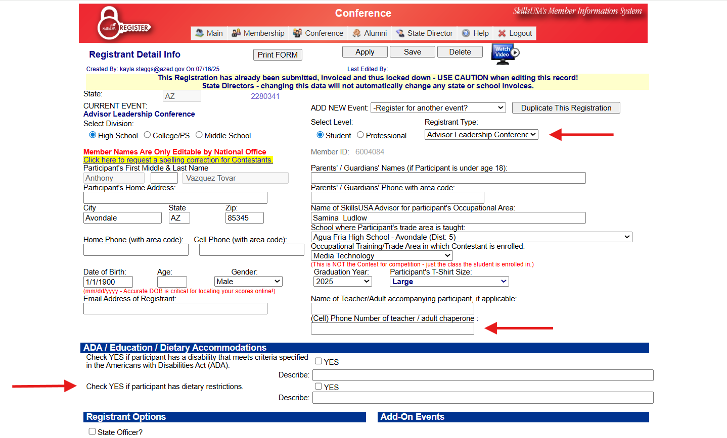
9. Complete the registration form and be sure to:
- Confirm your Registration Type is correct.
- Enter a cell phone number.
- Please describe any dietary restrictions or needs.
10. Click Save Registration at the bottom when complete.

